Slide 1
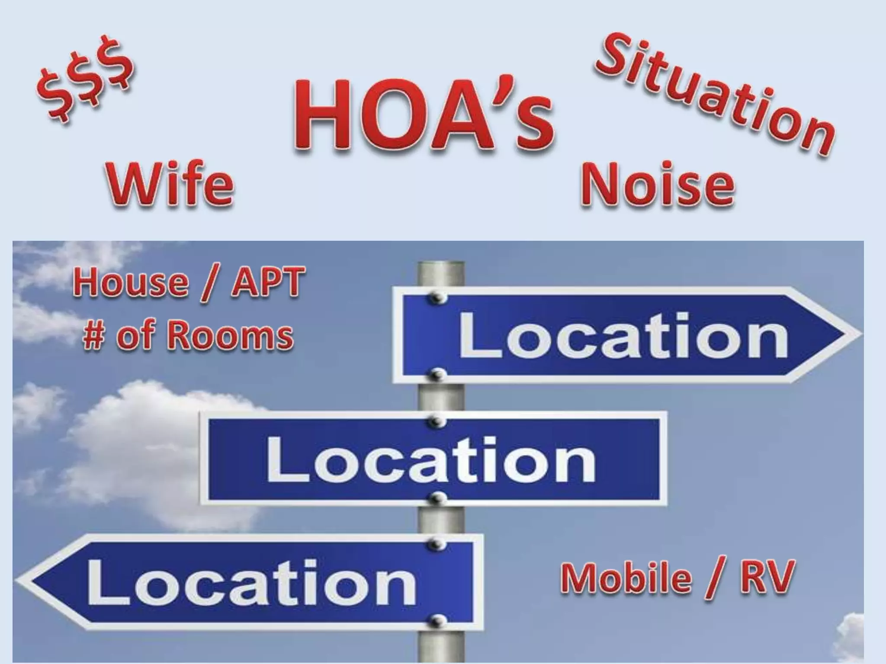

Slide 2
Copy of presentation on website
https://w5sc.org/meeting-presentations/

Slide 3

SOME Background first

Slide 4
Digital Radio
Different radio brands
Different protocols (D-Star, DMR, Fusion)
Different requirements to use

Slide 5
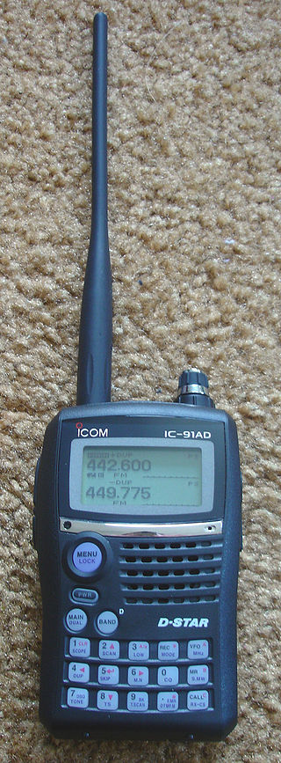
D-STAR (Digital Smart Technologies for Amateur Radio)
is a digital voice and data protocol specification for amateur radio. The system was developed in the late 1990s by the Japan Amateur Radio League and uses minimum-shift keying in its packet-based standard. There are other digital modes that have been adapted for use by amateurs, but D-STAR was the first that was designed specifically for amateur radio.
Notes:
Icom: Icom is the primary manufacturer of D-STAR radios, offering various models including handhelds, mobiles, and base stations.
Kenwood: Kenwood also produces D-STAR radios, with models like the TH-D74A and TH-D75A.
FlexRadio Systems: FlexRadio Systems also manufactures D-STAR compatible radios.

Slide 6
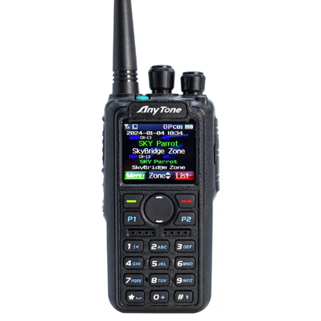
DMR stands for "Digital Mobile Radio"
which is an international standard for two-way radio communication, allowing different manufacturers' devices to operate together on the same network, providing digital voice and data transmission over radio frequencies; essentially, it's a digital upgrade from traditional analog radio systems.
The FCC officially approved the use of DMR by amateurs in the USA in 2014.

Slide 7
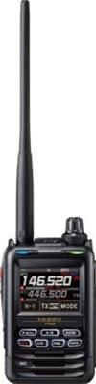
Digimode "Fusion"
In 2013, YAESU launched its own digital mode of operation for amateur radio: "System Fusion". Like other digital modes, Fusion utilize a narrower radio bandwidth. With System Fusion, special attention was paid to compatibility with analog FM radio. This was intended to simplify migration of the existing amateur radio repeaters from analog to digital technology.
Yaesu is the only company with System Fusion-enabled devices. ICOM, alongside the Japan Amateur Radio League has developed devices using the D-STAR protocol. Other brands use DMR, among other modes.

Slide 8


So I need 3 different digital radios

Slide 9
Digital “Radio” alternative
Can use with Technician License
Get into digital radio without a expensive radio
No antennas, power supplies, etc
Portable operation possible (can get on the “air” from virtually anywhere)
Talk worldwide –
However
Need computer (Laptop) running win 10 or above
Need internet access
Can use with cell phone as hotspot

Slide 10
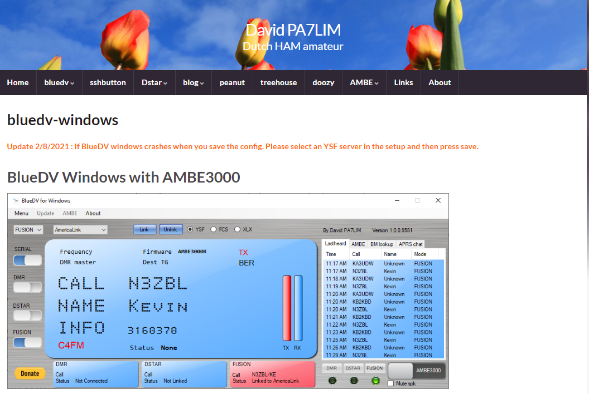
So I don’t really need 3 different Radios
Software solution

Slide 11
Its been out how long?
Yes, it has been out since 2016 and now we are finding out about it.

Slide 12
With BlueDV Windows and an AMBE3000 you can make a QSO via your sound card. No hotspot or radio’s are needed. For around $120 you can make QSO’s on DMR, DSTAR and Fusion.
Some users ask me why other software can use DSTAR, Fusion and DMR without DVSI AMBE3000. Keep in mind! This is NOT legal! You are breaking the DVSI patents!
BlueDV windows supports the following DV protocols.
DSTAR
DMR
Fusion ( YSF, FCS ) ( only in DN mode )
NXDN (Next Generation Digital Narrowband)
Notes:
XDN stands for Next Generation Digital Narrowband, and is an open standard for public land mobile radio systems; that is, systems of two-way radios (transceivers) for bidirectional person-to-person voice communication. It was developed jointly by Icom Incorporated and Kenwood Corporation as an advanced digital system using FSK modulation that supports encrypted transmission and data as well as voice transmission. Like other land mobile systems, NXDN systems use the VHF and UHF frequency bands. It is also used as a niche mode in amateur radio.

Slide 13
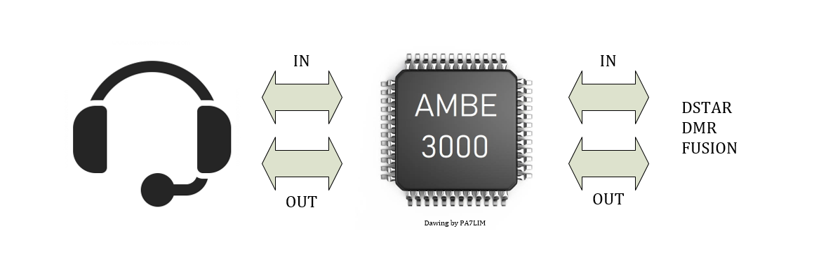
What is AMBE3000™.
Digital Voice System’s AMBE-3000™ Vocoder Chip is an extremely flexible, voice compression solution that sets a new standard for quality, high-performance speech compression hardware. The AMBE-3000™ Vocoder Chip is a DSP-based vocoder that provides exceptional voice quality at rates as low as 2000 bps. The AMBE-3000™ Vocoder Chip offers the affordability and mobility required by virtually all full or half-duplex mobile communication devices. Its superior performance and flexible design configurations makes it an ideal choice for commercial, consumer and military communication applications.
In other words. The chip can convert PCM audio to and from digital voice ( DSTAR, DMR and Fusion ).

Slide 14
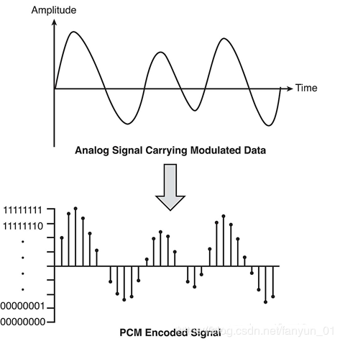
What is PCM?
Pulse-code modulation (PCM) is a digital audio format that converts analog signals into digital data. It's the standard digital audio format for computers, CDs, and digital telephony.

Slide 15
Hardware & Software
BlueDV windows software works with the following AMBE3000 solutions
NWDR ThumbDV https://wuwt.myshopify.com/products/thumbdv%E2%84%A2
DVMEGA DVStick https://www.gigaparts.com/dvmega-dvstick-30.html
ZUM AMBE board https://www.hamradio.com/detail.cfm?pid=H0-017021
The AMBE3000 ( ThumbDV/DVStick30) chips support the most common Fusion DN mode* ( voice narrow ) and not the WV ( Wide Voice ) mode.
You can download the latest version at the following location : https://software.pa7lim.nl/
* The VW (Voice Wide) mode takes up the whole 12.5 Khz bandwidth for voice where the DN (Digital Narrow) mode takes up the 6.25 Khz bandwidth.

Slide 16
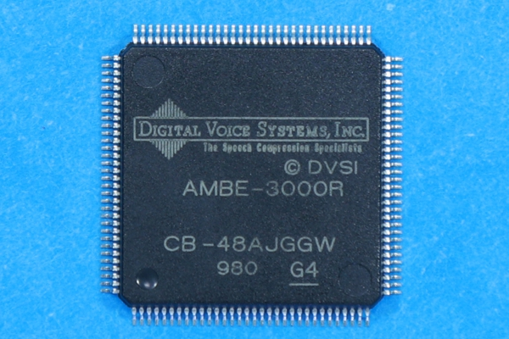
Buyers Beware!
Pirated Vocoder Products and Software!
Don’t buy China knock offs- they do not have all the functionality of the licensed one. (AMBE-3000R)

Slide 17
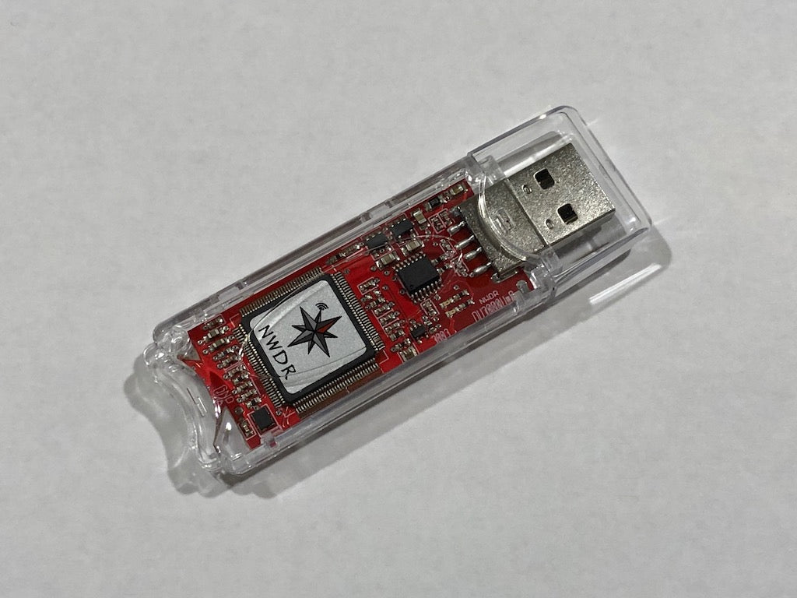
Only 3 parts to make it work.
1 – Laptop/ pc running windows 10/11
3 –FREE Blue dv software
2 --ThumbDV (USB) ~$120

Slide 18
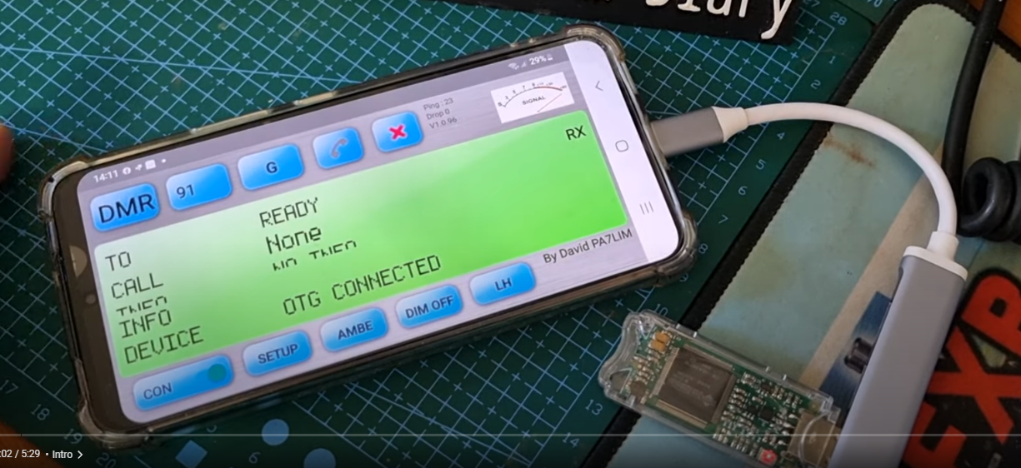
I don’t use windows
DVSTICK 30 Android Set up (No PC Needed )
https://www.youtube.com/watch?v=yHnt_azjcSo
An OTG or On The Go adapter (sometimes called an OTG cable, or OTG connector) allows you to connect a full sized USB flash drive or USB A cable to your phone

Slide 19
Yes, there is Linux,
Raspberry Pi also
https://hamradiosouthernrepeaters.co.uk/bluedv-setup.html
NOTE: IOS phone/ipad no longer work with revs above 10.0
Currently most users are using 18 and above.

Slide 20
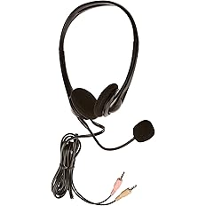
Hints:
Make sure you have an USB port with sufficient power & Disable USB Power Management
Set the AMBE3000 baudrate to 460800 in BlueDV
NOTE- Use same usb port every time for consistent success
BlueDV Windows works in Windows 10 & 11.
Manual: http://radioham.mydns.jp/bluedv/BlueDVWindows.pdf
The software is free to use. He wrote this software just for fun. So no support
https://nw-digital-radio.groups.io/g/main/topics
Headset with mic easier to use in noisy environment
  (Dragon Stereo Communication/
  Skype Headset HS-GEN-C) Amazon ~$10

Slide 21
Needed for DMR & D-Star ID
A DMR ID is a unique number that identifies a radio on a Digital Mobile Radio (DMR) network. It's similar to a phone number that allows a radio to make and receive calls
How to register for a DMR ID.
Do you need to register for D-Star, the answer here is not quite as clear cut as it once was, in order to use Icom G2 or Icom G3 systems, yes you need to have your callsign registered with the Icom network.
How to register on the D-Star Network (Required for REF reflectors, not XRF/XLX reflectors)
It is FREE to register

Slide 22
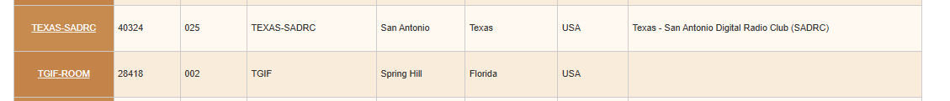
How to make contact
Nets (Something going on every day.)
https://www.bridgecomsystems.com/pages/amateur-radio-digital-nets
https://brandmeister.network/?page=lh (Last heard) See what's active
https://www.pistar.uk/dmr_bm_talkgroups.php PiStar (There are 1686 available TalkGroups on the BrandMeister network.)
Use the WIRES-X website:https://www.yaesu.com/jp/en/wires-x/id/id_usa.php

Slide 23
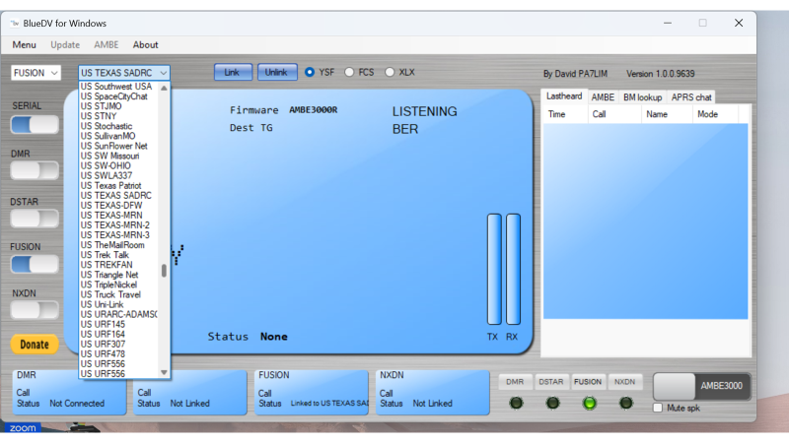

Slide 24
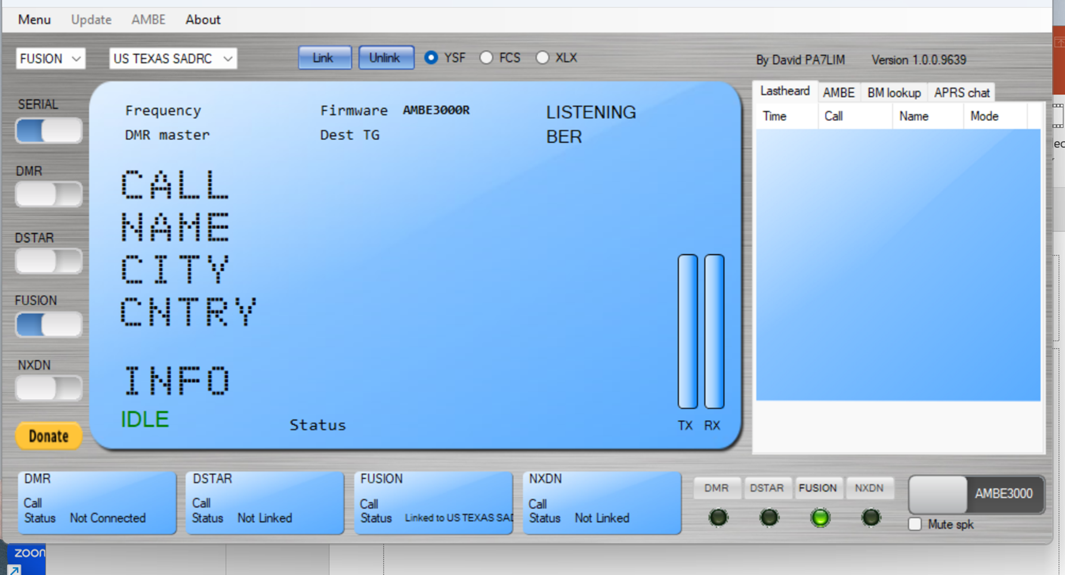
xmit

Slide 25
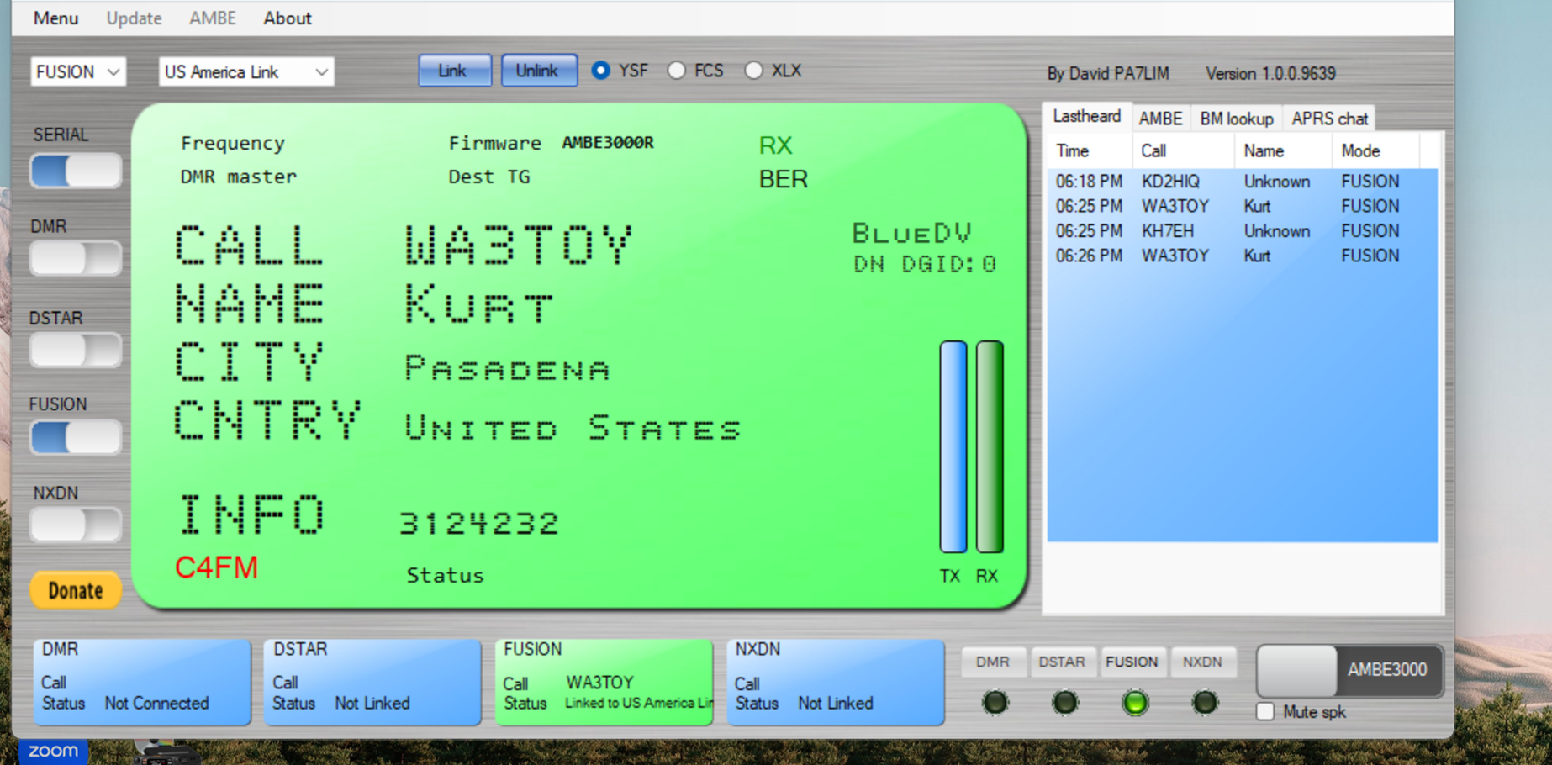
Receive mode active

Slide 26
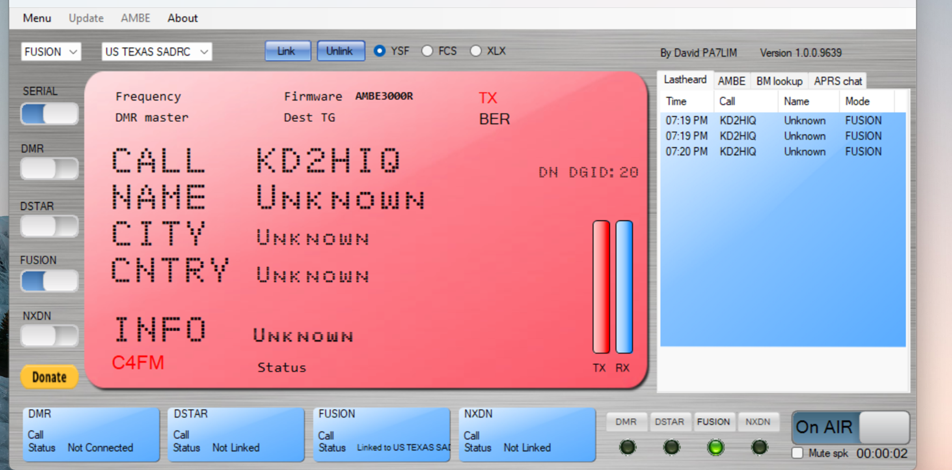

Slide 27
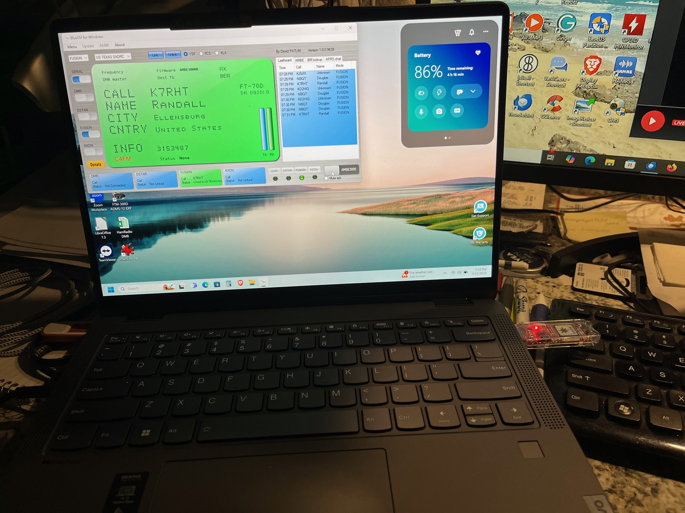
NWDR ThumbDV

Slide 28
Have Confidence ( make new friends)
Listen first
No need to call CQ
Wait a minimum of 3 seconds after last transmission to begin to talk
Just say your call sign, listening -- then wait – talk normal
Every Wednesday US Texas SADRC has a net at 7pm – jump in
See http://www.sadrc.net/ for list of connected repeaters & frequencies

Slide 29


